Slide 1
Digital Portfolio
STUDENT NAME : vivek k
REGISTER NO AND NMID : 222402519/asunm161222402519
DEPARTMENT : BSc.Computer science
COLLEGE: COLLEGE/ UNIVERSITY : Prince Shri Venkateswara Arts
And Science College/Madras University

Slide 2
PROJECT TITLE :
Digital Portfolio

Slide 3


AGENDA
Problem Statement
Project Overview
End Users
Tools and Technologies
Portfolio design and Layout
Features and Functionality
Results and Screenshots
Conclusion
Github Link
3/21/2024 Annual Review

Slide 4

PROBLEM STATEMENT
Traditional resumes and paper-based records often fail to effectively showcase an individual’s skills, achievements, and creativity. There is no unified platform that highlights both academic and professional growth in an engaging way. This creates challenges in standing out to employers, educators, or peers. A digital portfolio is needed to provide a structured, dynamic, and accessible representation of one’s work and abilities.

Slide 5

PROJECT OVERVIEW
In the modern digital era, individuals struggle to present their skills and achievements effectively using traditional resumes or certificates. These methods are often static and fail to reflect creativity, growth, and practical experience. Employers and educators also face difficulty in evaluating true potential through such limited formats. A digital portfolio offers a dynamic platform to showcase talents, projects, and accomplishments in an organized and accessible way.

Slide 6

WHO ARE THE END USERS?
Potential Employers/Recruiters – to evaluate skills, projects, and experience.
Clients/Collaborators – to explore work samples before partnerships.
Peers/Community – for networking, learning, and inspiration.

Slide 7

TOOLS AND TECHNIQUES
Vs code - Code Editor
HTML – Structure purpose
CSS – Styling purpose
Github – Hosting Platform

Slide 8
POTFOLIO DESIGN AND LAYOUT
Section include:
Home
About
Skills
Contact
8
Notes:
Section included:
.home
.

Slide 9
FEATURES AND FUNCTIONALITY
Features
Responsive Layout
Navigation Bar
Hero Section
About Section
Responsive Design
Hover Effects

Slide 10
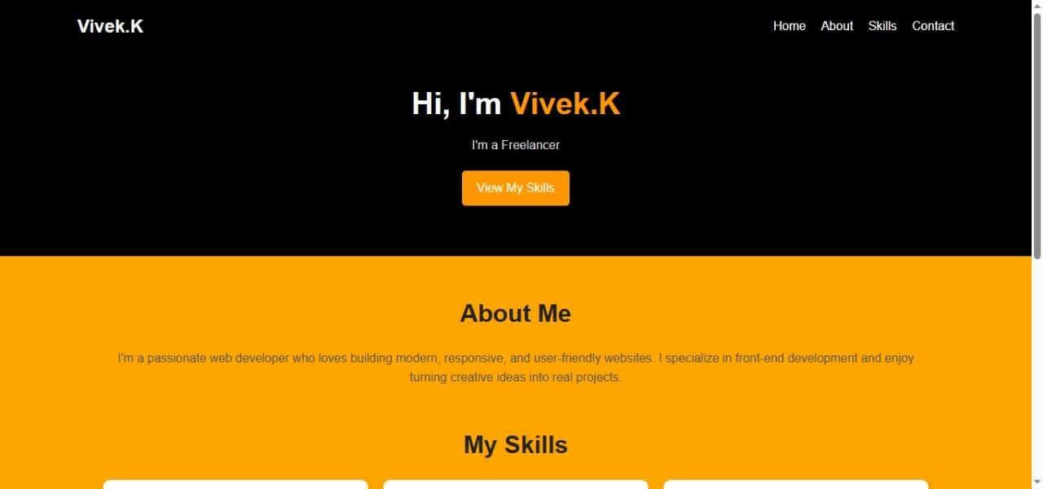

RESULTS AND SCREENSHOTS
3/21/2024 Annual Review
10

Slide 11
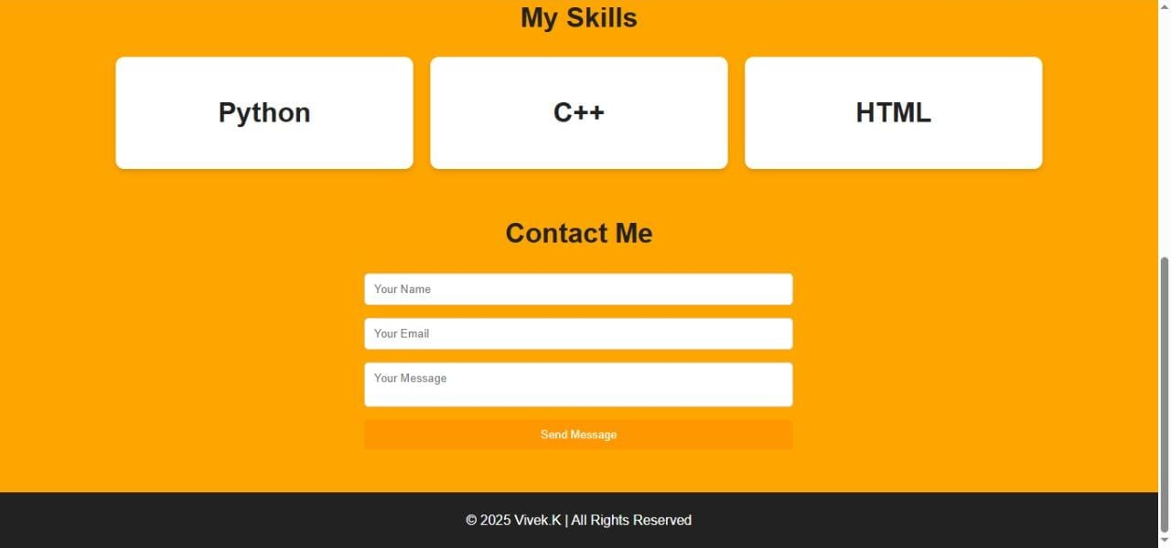

Slide 12
CONCLUSION
My portfolio reflects my skills, knowledge, and achievements in an organized way. It serves as a platform to showcase my growth, creativity, and dedication. This portfolio will help me explore new opportunities and move closer to my career goals.
12

Slide 13
Github Link :
https://13647cs2024vivek.github.io/TNSDC-FWD-DP/

